Slide 1

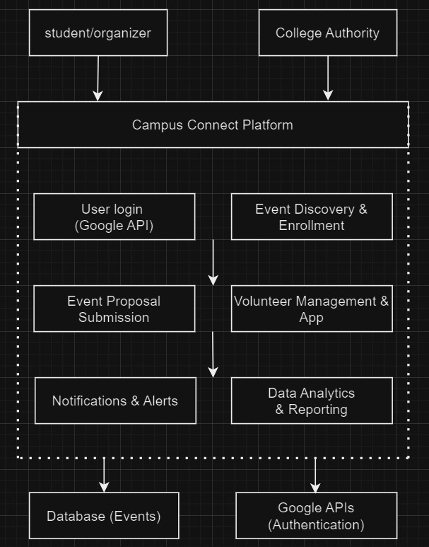
Proposed Architecture/ Diagram:
MIT SCHOOL OF COMPUTING
Class : TYCORE1
Group Id: 119
DEPARTMENT OF COMPUTER SCIENCE & ENGINEERING
Campus Connect
Jayesh Mathur,Mayank Modi,Ritwick prabhat,Himanshu Gujrathi
Faculty Guide:
Prof. Deepa Mishra
Empathy Chart
Ideation
Inspired by student struggles with fragmented event information, complex proposal processes, and unclear volunteering roles, “Campus Connect" was conceived. This platform centralizes event details, simplifies proposal submissions with automated approvals, and streamlines volunteer management. "Campus Connect " offers a unified interface for students to register, propose, and volunteer for events, while providing organizers and authorities with efficient management tools.
Block Diagram
User Segment:
Students attending, organizing, or volunteering for events.
Event organizers managing events.
College authorities overseeing event approvals
User Feels:
Overwhelmed by scattered event info.
Frustrated with complex approval processes.
Anxious about missing deadlines.
Eager but unclear about volunteering opportunities.
User
User Thoughts:
"I need one place for all event info."
"I want a quicker approval process.“
"How do I find volunteering roles?"
User Action:
Checking multiple sources for event details.
Submitting proposals through manual processes.
Problem statement
Create a platform for managing academic fests, enabling event discovery, enrollment, proposal approval, and volunteer coordination with authority oversight.
Proposed Solution
Develop "Campus Connect“, a unified platform for academic events. It offers seamless event discovery, enrollment, proposal submission, and volunteer management. Using Google APIs for secure authentication, it integrates real-time notifications, analytics, and a centralized database, streamlining event coordination and enhancing engagement for students, organizers, and authorities.
Scope and Feasibility
“Campus Connect" will manage academic event coordination, from discovery to volunteering. The project is feasible with existing technologies for secure user authentication (Google APIs) and real-time updates. It requires web development, database integration, and a user-friendly interface. It aligns with current tech trends and campus needs..

